Slide 1

ETL Project
data
Extract-Transform-Load
final
load
extract
proposal
transform

Slide 2
What Is Your Favorite
TV Show or Movie?
final
data
load
extract
proposal
transform
Brian Stogner
Angela Banko
Stephanie Hucks

Slide 3
Kaggle
Kaggle
Kaggle
1
2
3
final
Disney Plus
csv
Reviews
csv
Netflix TV Shows
csv
data
load
extract
proposal
transform

Slide 4



final
data
load
extract
proposal
transform
Disney Plus
Reviews
Netflix TV
IMDB id
Title
Year
Type
Rating
IMDB
Rotten Tomatoes
Ratings
Title
Year
Title
Release Year
Listed In
Rating
Type

Slide 5


01
Drop duplicates
02
Remove blanks values
final
transform
data
load
extract
proposal
X
03
Clean the range

Slide 6



PostgreSQL
final
load
data
extract
proposal
transform
Composite Primary Keys

Slide 7
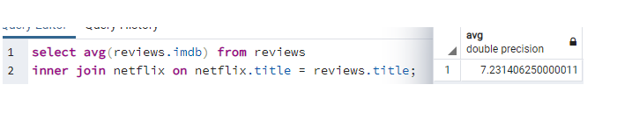
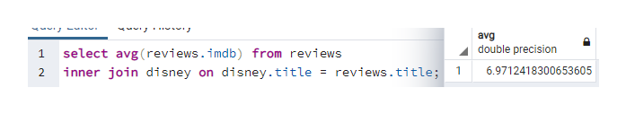
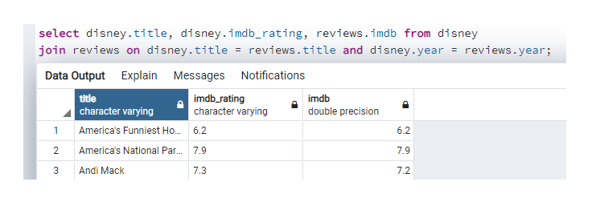
final
data
load
extract
proposal
transform

